Slide 1
CSE-3201 Operating Systems

Slide 2
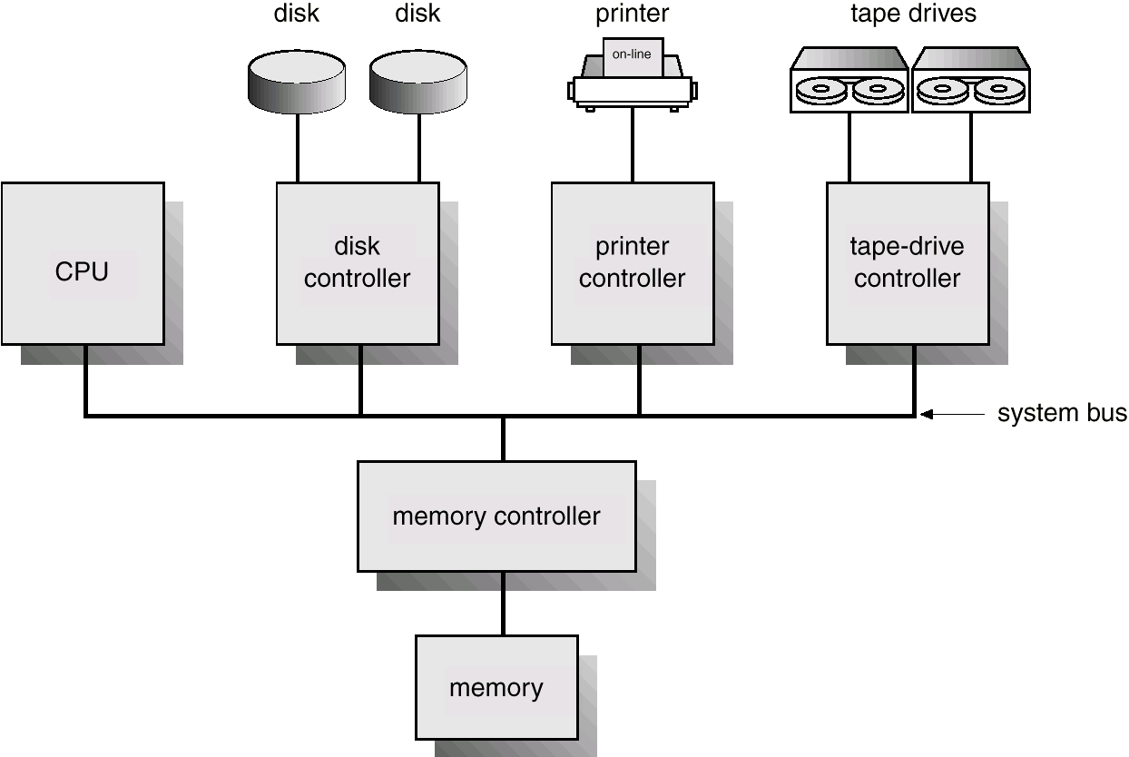
Computer System Architecture

Slide 3
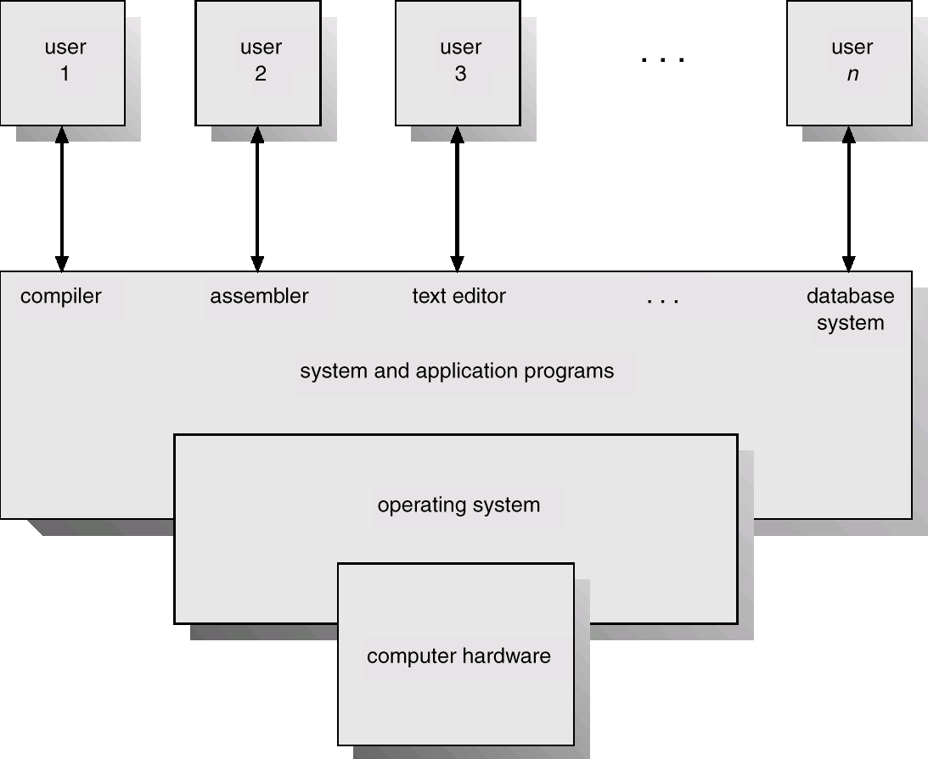
What is an Operating System?
An OS is a program that acts an intermediary between the user of a computer and computer hardware.
OS provides an environment in which other programs can do useful work
Conveniently
Efficiently

Slide 4
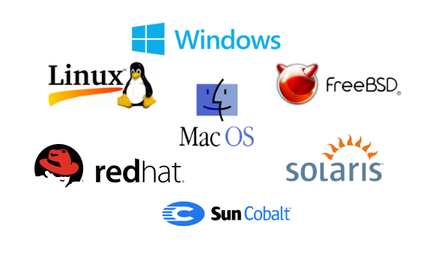
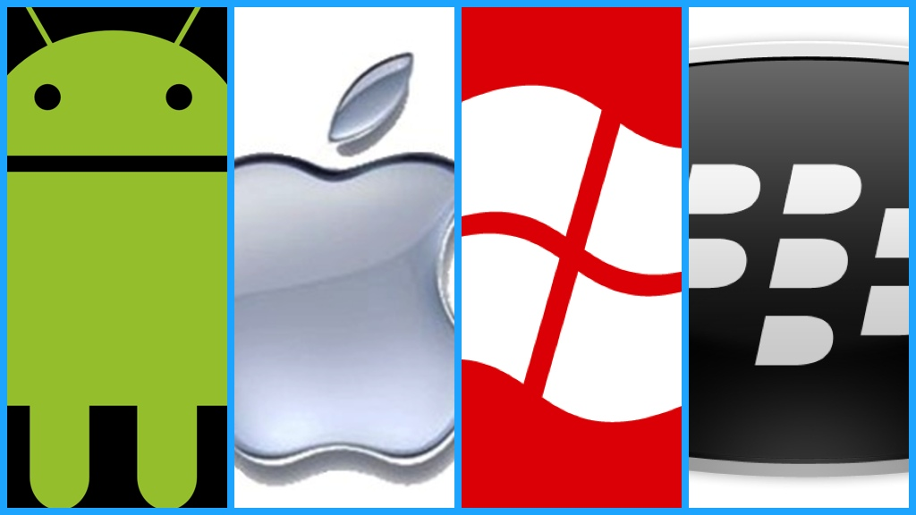
Operating Systems

Slide 5
Abstract View of System Components
User
1
User
2
User
3
...
User
n
System and Application Programs
compiler
assembler
Text editor
Database
system
Operating System
Computer
Hardware

Slide 6
Goals of an Operating System
Simplify the execution of user programs
Use computer hardware efficiently
Make application software portable and versatile
Provide isolation, security and protection

Slide 7
Why should I study Operating Systems?
Need to understand interaction between the hardware and applications
New applications, new hardware
Need to understand basic principles in the design of computer systems
efficient resource management, security, flexibility
Increasing need for specialized operating systems
e.g. embedded operating systems for devices - cell phones, sensors and controllers
real-time operating systems – vehicles, aircraft control, multimedia services

Slide 8
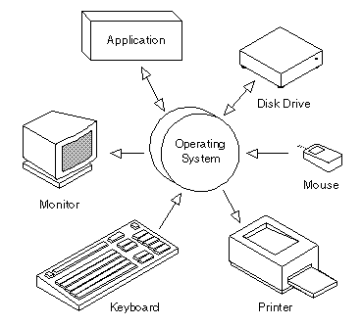
Why should I study Operating Systems?
Ecosystem of Computer system
Resource Allocation And Sharing
Parallel Computing
Cluster Computing
Grid Computing
Threading and Multithreading (cross Threading)
Multiprocessing system
Distributed Computing
Cloud Computing
Process Synchronization(semaphore, Lock variables)
Jobs Scheduling
Networking

Slide 9
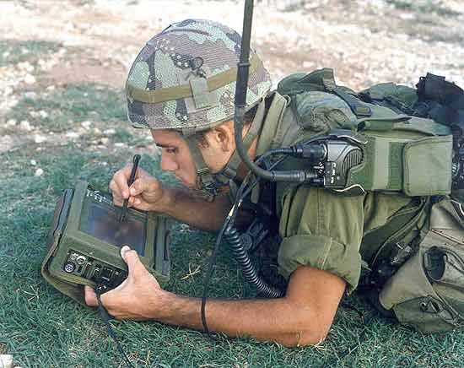
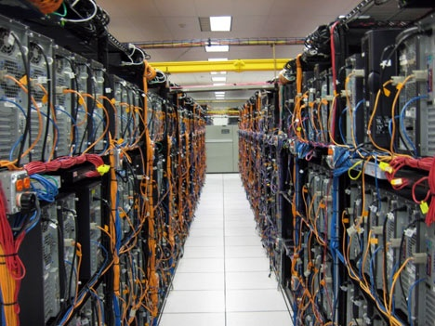
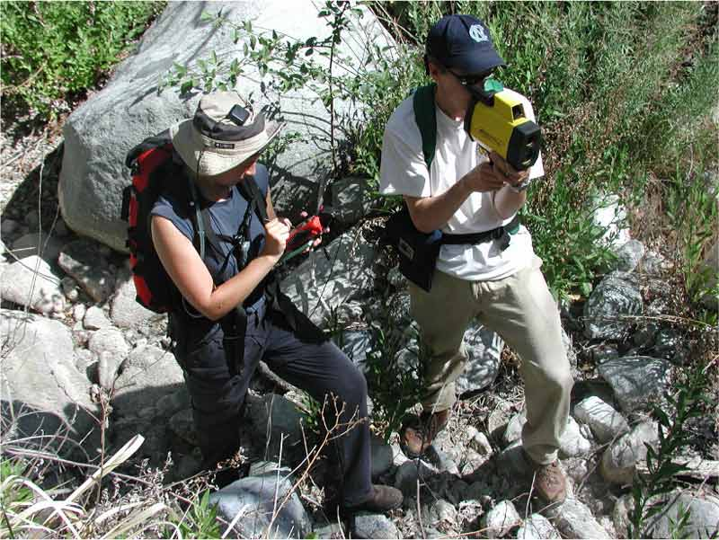
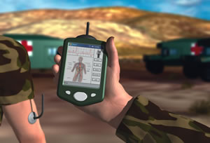
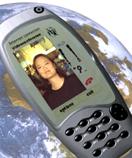

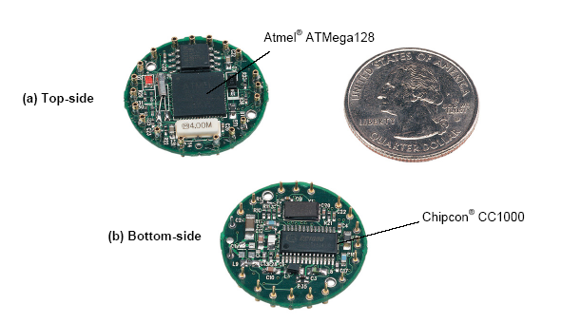
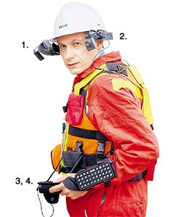
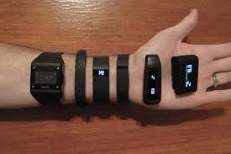
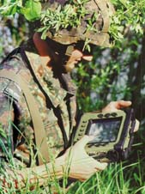

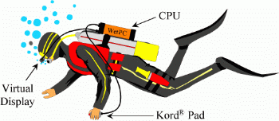

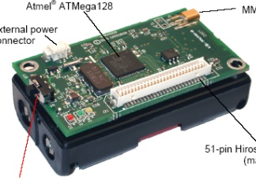
Systems Today and The Future

Slide 10
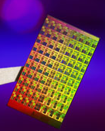
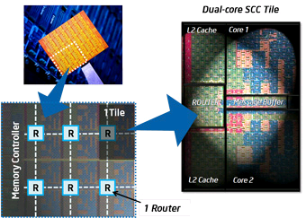
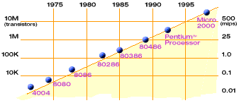
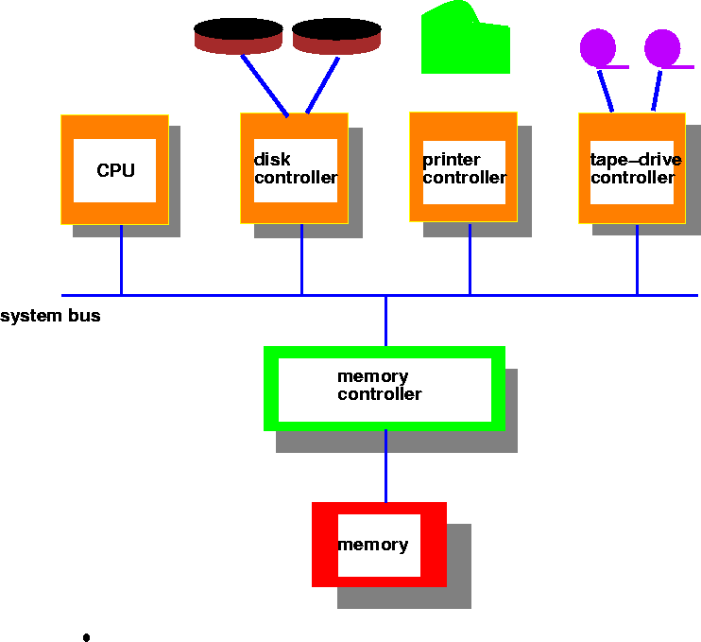
Hardware Complexity Increases
Moore’s Law: 2X transistors/Chip Every 1.5 years
Intel Multicore Chipsets
Moore’s Law

Slide 11
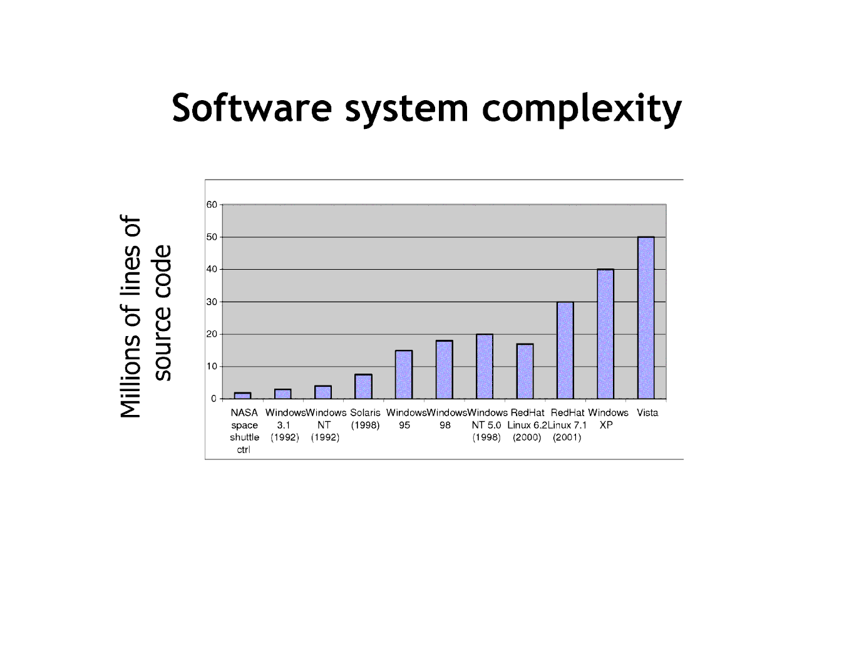
Software Complexity Increases

Slide 12
Operating System Views
Resource allocator
to allocate resources (software and hardware) of the computer system and manage them efficiently.
Control program
Controls execution of user programs
To prevent errors and improper use of the computer
Control operation of I/O devices.
Kernel
Many components running, what to call an OS?
One definition of OS - one program that runs at all times
Called kernel
Everything else: system programs and applications

Slide 13
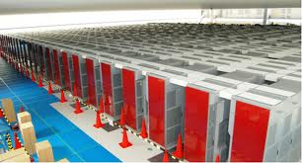
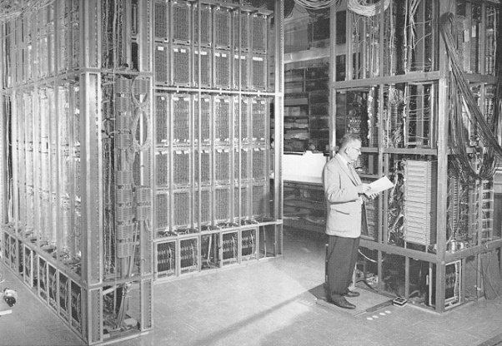
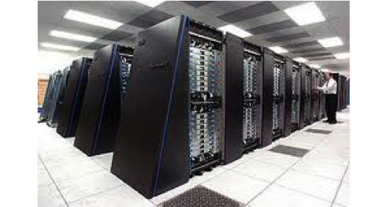
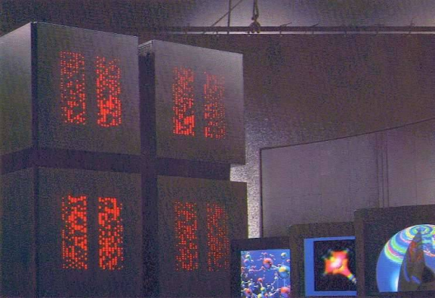
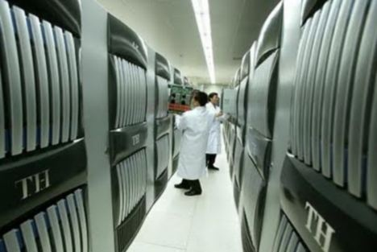
Parallel Computing Systems
ILLIAC 2 (UIllinois)
Climate modeling, earthquake simulations, genome analysis, protein folding, nuclear fusion research, …..
K-computer(Japan)
Tianhe-1(China)
Connection Machine (MIT)

Slide 14
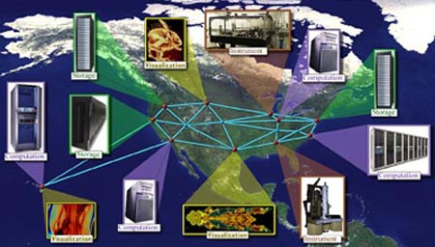
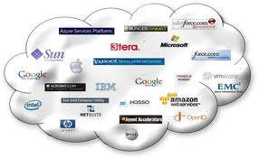
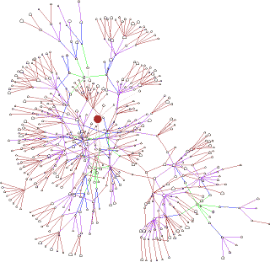
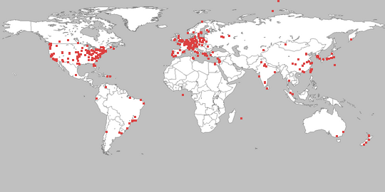
Distributed Computing Systems
Globus Grid Computing Toolkit
Cloud Computing Offerings
PlanetLab
Gnutella P2P Network

Slide 15
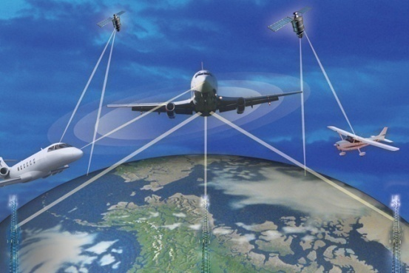

Real-time systems
Correct system function depends on timelines
Feedback/control loops
Hard real-time systems –
Failure if response time too long
Soft real-time systems -
Less accurate if response time is too long
Useful in applications such as multimedia, virtual reality.

Slide 16
Course outline
Operating-System Structures
Operating System Services
System Calls
System Programs
Operating System Structure

Slide 17
Course outline
Process management:
Basic Concept
Process Scheduling
Operation On process
Co-operating processes
Inter Process Communication
Kernel

Slide 18
Course outline
Threads
Basic Concept
Multi Threading Model
Threading issues
Cost and Benefit analysis of thread

Slide 19
Course outline
CPU scheduling
Basic concepts
Scheduling Criteria
Scheduling algorithm
Algorithm Evaluation

Slide 20
Course outline
Process synchronization
Critical section Problem
Synchronization hardware
Semaphores
Classic Problems of synchronization

Slide 21
Course outline
File Systems
File naming
File types
File structure
File access

Slide 22
Course outline
Virtual Machine & Distributed System
Building block
Virtualization and Operating-System Components
Advantages of Distributed Systems
Types of Network-Based Operating Systems
Distributed File System

Slide 23
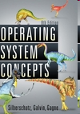
Text Books
Operating System Concepts 9th Edition
By Abraham silberschatz, Peter Baer Galvin,
Greg Gagne
Operating Systems Design and Implementation, Third Edition
By Andrew S. Tanenbaum, Albert S. Woodhull

